Slide 1



Early virologic and immunologic events following untreated or treated acute HIV infection
Thumbi Ndung’u, BVM, PhD
Investigator, Africa Health Research Institute (AHRI)
Professor and Director, HIV Pathogenesis Programme (HPP), Doris Duke Medical Research Institute
Nelson R. Mandela School of Medicine
University of KwaZulu-Natal
HIV Transmission: Virus, host and microbiome session
IAS 2018 Conference, Amsterdam, Netherlands
24 July June 2018

Slide 2
Disclosures
Thumbi Ndung’u has received HIV cure research grant funds from Gilead Sciences, Inc.

Slide 3
Lessons from treated acute HIV-1 infection
Fiebig I/II Fiebig III-VI
Fiebig I/II: anti-HIV humoral immune responses undetectable, viral load on upward trajectory
≥ Fiebig III: humoral immune responses detectable, peak viremia or past
Viral load
Year 1
Key questions:
Characteristics of the transmitted/founder virus?
Immune responses in acute HIV-1 infection- why do they fail? What is the impact
of T/F virus? Impact on reservoir? Impact of early treatment?
Can we mimic effective immune responses or augment ineffective immune
responses for better vaccines or cure?

Slide 4
FRESH study cohort
FRESH: Females Rising through Education, Support and Health
Recruit women 18 to 23 at very high risk of HIV infection
  Provide an intensive empowerment, life-skills and job readiness curriculum that coincides with the sample collection protocol.
Empowerment and training program coincides with twice per week HIV RNA testing for 9 months. Serial pre- and post-infection samples (blood, FGT and lymph nodes) are collected.
Study host and viral factors associated with acquisition and disease progression- T/F virus, antiviral immune mechanisms.

Slide 5
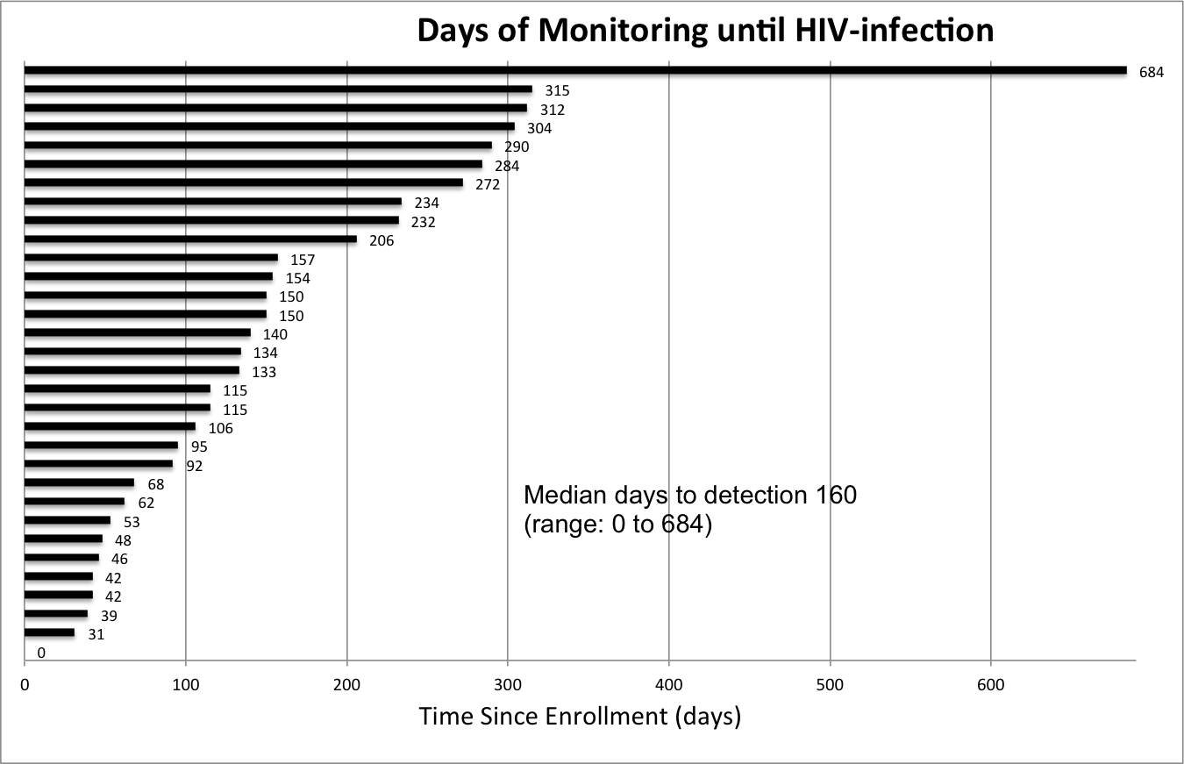
71 acute infections detected
As of April 2018:
> 1,600 enrollees
Incidence 8.3 (95% CI=5.8-12.0) per 100 p/y
14 untreated, 57 treated early
> 70% Fiebig I
Median 4 days since last negative HIV RNA
ART started within median 1 day

Slide 6
Early treatment intensification with raltegravir reduces the time to full suppression

Slide 7
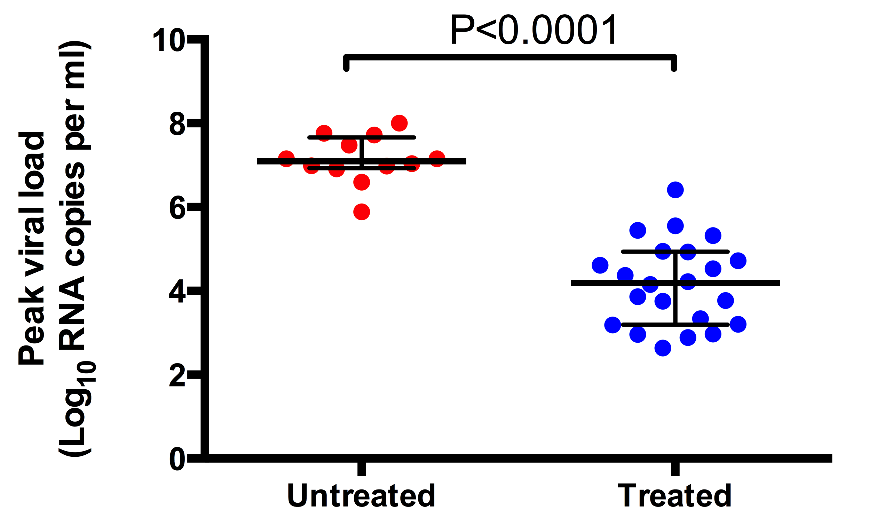
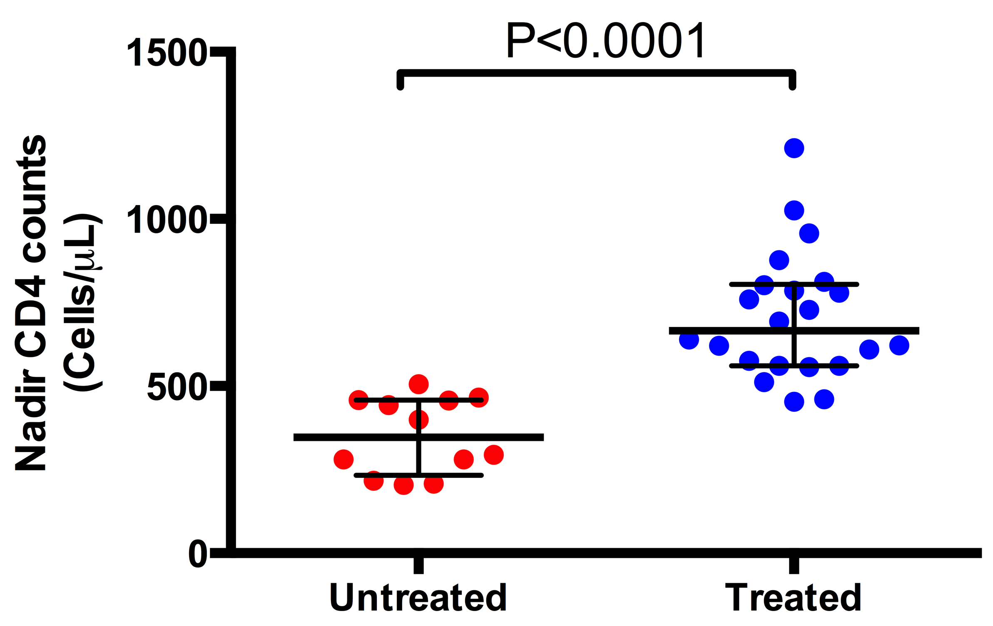
cART started in Fiebig stage I blunts peak viremia and preserves CD4 T cells

Slide 8
Participants treated in Fiebig stage I do not seroconvert*
*WB- Biorad GS kit

Slide 9
Most Fiebig I treated patients develop HIV-specific CD8⁺ T cell responses
Overall, almost all participants who started treatment in Fiebig I developed CTL
responses:
16 of 20 (80%) by tetramer staining
18 of 26 (69%) by IFN-γ ELISPOT
18 of 20 (90%) by CFSE proliferation

Slide 10
Frequency of individual tetramer⁺ CD8⁺ T cells is lower in early treated but are more functionally competent

Slide 11
CD8+ T cell subsets in peripheral circulation
Naïve T cells
Effector memory
Transitional memory
Central memory
CD8+ T cells can be classified into 3 distinct memory populations:
central memory TCM (CD45RA⁻CD27⁺, CCR7⁺),
transitional memory TTM (CD45RA⁻CD27⁺CCR7⁻) and
effector memory TEM (CD45RA⁻CD27⁻CCR7⁻)
HIV infection skews T-cell phenotype towards the suboptimal and ineffective transitional memory (TTM) phenotype
Hansen et al., Nature 2011; Hansen et al., Nat Med 2011; Burgers et al., J Imm 2009; Champagne et al., Nature 2001

Slide 12
Early ART shifts HIV-specific CD8⁺ T cells from transitional memory to effector memory phenotype

Slide 13
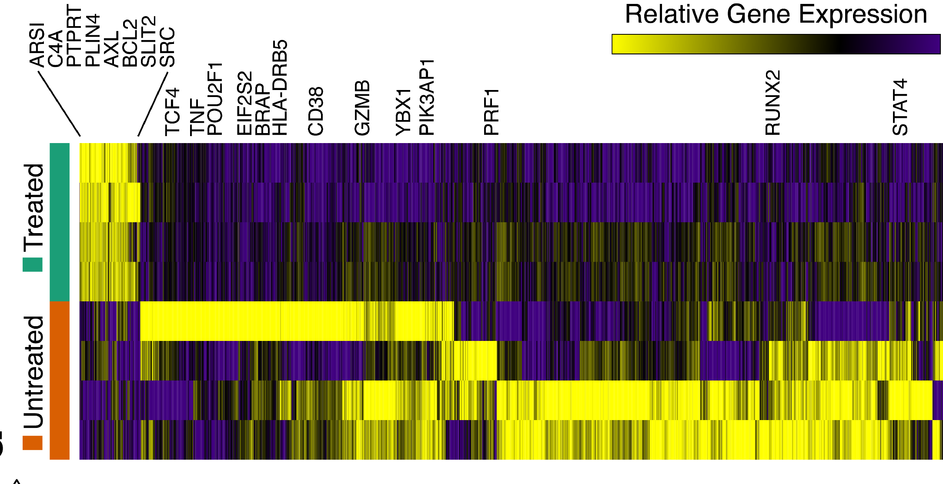
Early ART initiation modulates the transcriptional profile of HIV-specific CD8+ T cells

Slide 14
bNAbs for HIV therapy and functional cure strategies
Several broadly neutralizing (bNAbs) have been shown to prevent SHIV infection in macaques and to suppress viremia in HIV infected persons
bNabs can suppress rebound during ART interruption (Scheid et al, Nature, 2016; Caskey et al, Nat Med, 2017)
Therapy with a monoclonal antibody elicits host immune responses against HIV/SHIV (Schoofs et al, Science, 2016; Nishimura et al, Nature, 2017)
bNAbs used in protection studies clear HIV in distal sites (Liu et al, Science, 2016)

Slide 15
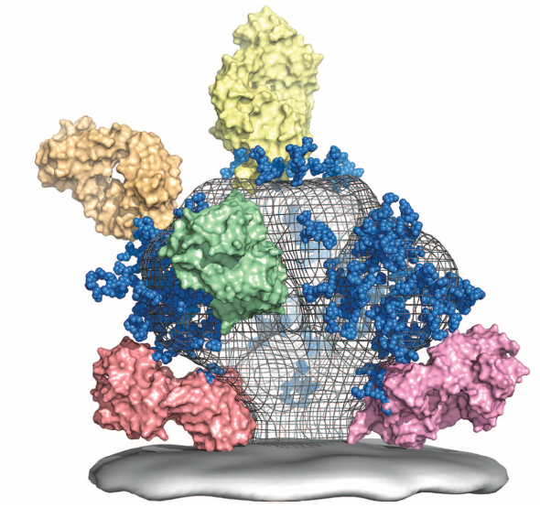
What about sensitivity of transmitted/founder virus to bNAbs?
C3/V3 (glycan dependent) –
2G12, PGT128, PGT121, PGT135
V1V2 (glycan dependent) – PG9, PG16, PGT141-145, CH01-04, CAP256-VRC26, PGDM1400
CD4 binding site b12, VRC01, 3BNC117, HJ16, NIH45-46, CH31, CH103, 12A12
gp120-gp41 interface (glycan dependent) PGT151, 35O22, CAP248 30.2B
MPER – 4E10, 2F5, z13, 10E8
Adapted from Burton et al, Science, 2012

Slide 16
No single bNAb neutralizes all the transmitted/founder viruses in FRESH with great potency
However, PGT151, PGT121, PGDM1400, and CAP256 show good coverage
bNab | T/F viruses |  |  |  |  |  |  |  |  |  | Subtype C Viruses
 | 093 | 208 | 268 | 079 | 318 | 036 | 271A | 271B | 267 | 186 | CAP45 | Du172 | CAP239 | ZM197
VRC01 | 0.59 | >10 | >10 | 2.18 | 0.92 | 0.23 | 0.32 | 6.37 | 1.33 | 0.4 | >10 | >10 | >10 | 0.72
PGT151 | 0.06 | 0.02 | 0.03 | 0.02 | 0.2 | <0,005 | 0.06 | 0.04 | 1.52 | 0.01 | 0.02 | 0.02 | 0.04 | 0.03
10 E8 | 0.64 | 1.31 | 0.51 | 1.4 | 0.52 | 0.91 | 1.05 | 2.43 | 0.17 | 0.5 | 0.16 | 0.03 | 0.34 | 0.18
PGDM1400 | 0.09 | 0.3 | 9.29 | <0,005 | >10 | <0,005 | >10 | <0,005 | <0,005 | 0.01 | <0,005 | 1.63 | <0,005 | 0.07
PGT121 | <0,005 | 0.04 | 0.06 | >10 | 0.02 | <0,005 | >10 | >10 | 0.09 | 0.02 | >10 | 0.01 | <0,005 | >10
3BNC117 | >10 | 0.06 | >10 | >10 | 0.06 | 0.07 | 0.55 | >10 | 0.14 | 0.1 | 0.85 |  | >10
CAP256 | 0.01 | 0.46 | >10 | <0.005 | <0.005 | 5.48 | 0.19 | <0.005 | <0.005 | <0.005 | <0.005 |  | <0.005
SK POOL | 1006 | 101 | 186 | 2477 | 1832 | 945 | 203 | 1388 | 478 | 504 | 2544 | 337 | 1056 | 535
 |  |  |  |  | <0,1 µg/ml
 |  |  |  |  | 0,9 - 0,1
 |  |  |  |  | 3,0 - 0,91
 |  |  |  |  | 10,0 -3,1
 |  |  |  |  | >10
T/F Env pseudotyped viruses were
assayed in the TZM-BL luciferase assay

Slide 17
Total DNA reservoir is similar in early treated versus untreated participants at hyperacute infection phase

Slide 18
Total HIV DNA decays steadily in early treated patients
A. Early treated patients
B. Untreated patients

Slide 19
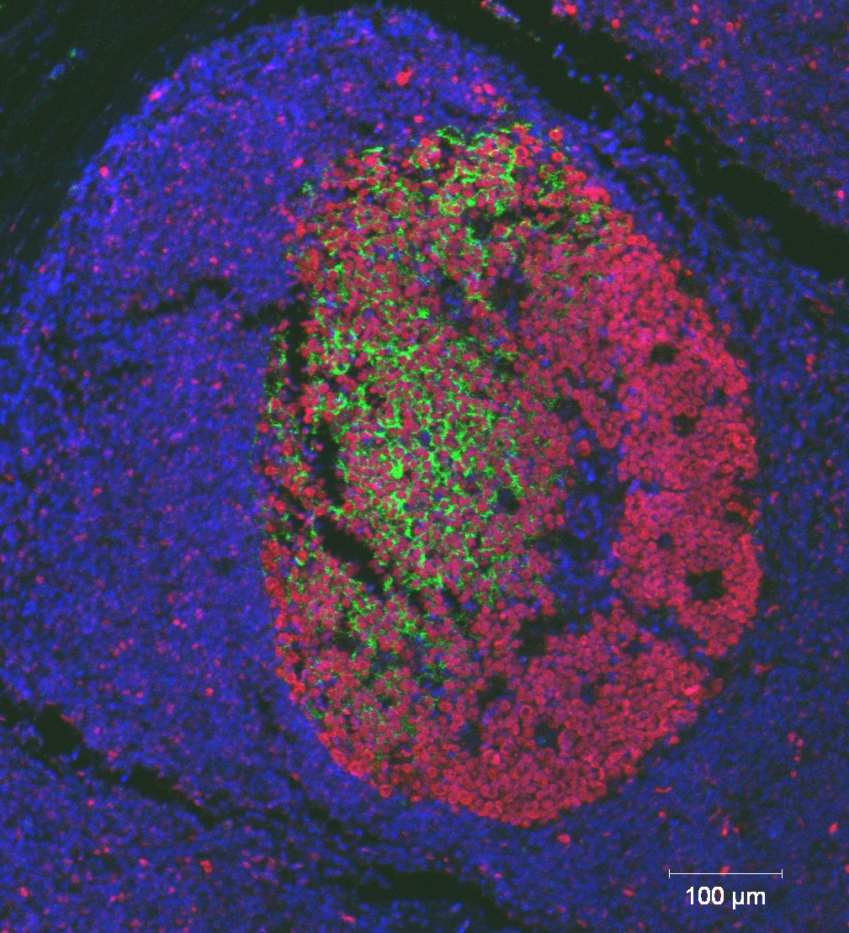
HIV persists in lymph nodes of immediately treated participants
p24+ cells co-localize with BCL6+
cells in the germinal centers
p24
BCL6
Acute 53 (PID 127-33-0942-683)
DAPI
CD4
Viral load
Age: 19
VL: <20 cps/ml
DAPI Nuclei
CD4
HIV Gag-pol RNA

Slide 20
Conclusions
Acute HIV infections- novel insights into characteristics of T/F virus, immune responses and reservoir establishment
Study participants initiated on cART during Fiebig stage I/II show diminished magnitude of humoral and CTL immune responses but the latter may be more functional- durability and location?
In FRESH, the reservoir is established very early and even in Fiebig I treated participants, the size during acute infection is similar to untreated participants, persistence in lymphoid tissues
Early initiation of cART leads to slow but steady decay of the reservoir, which may have implications for ease of cure.
Combination approaches- early treatment + specific antiviral-immune agents (bNAbs) that target sanctuary sites and harnessing a patient’s own immune system may be required for a functional cure

Slide 21







Acknowledgements
AHRI and HPP- UKZN
Krista Dong
Amber Moodley
Zaza Ndhlovu
Kavidha Reddy
Omolara Baiyegunhi
Jenn Mabuka
Bongiwe Ndlovu
Kamini Gounder
Daniel Muema
Nasreen Ismael
Prince Mshiyeni Hospital
Johann Pansegrouw
FRESH study participants
FRESH study team
Harvard/MGH
Bruce Walker
Galit Alter
Mathias Lichterfeld
Guinevere Lee
Douglas Kwon
Musie Ghebremichael
Alex Shalek
Sam Kazer
Funding
Bill and Melinda Gates Foundation
IAVI
NIH
South African DST/NRF
HHMI
Gilead Sciences, Inc.

